Slide 1

Getting hands on with XAML and Xamarin.Forms
Mitch “Rez” Muenster
@MobileRez
mobilerez.tumbler.com
Xamarin Certified Developer

Slide 2
Objectives
Understanding Xamarin.Forms
XAML Syntax & Behavior
Advanced XAML
Notes:
For our objectives today,
cover Xamarin.Forms to get a better understand of what it is and the layouts that exist within Forms
Then We will be getting into a understanding of XAML, its Syntax and Behavior and how it works with Xamarin.Forms
and then touching on a few advanced XAML concepts that can be used with your Xamarin.Forms app to bring in adisi

Slide 3
Understanding Xamarin.Forms

Slide 4
What is Xamarin.Forms?
Xamarin.Forms allows you to rapidly create a cross platform app with a native UI.
Can be created in either a Shared Class Library or Portable Class Library
Great for Prototyping or Data-Driven apps.
Can also use dependency service to access platform specific features.

Slide 5
Understanding Xamarin.Forms UI
Xamarin.Forms UI is defined in 4 different ways; Pages, Layouts, Cells, and Views.

Slide 6
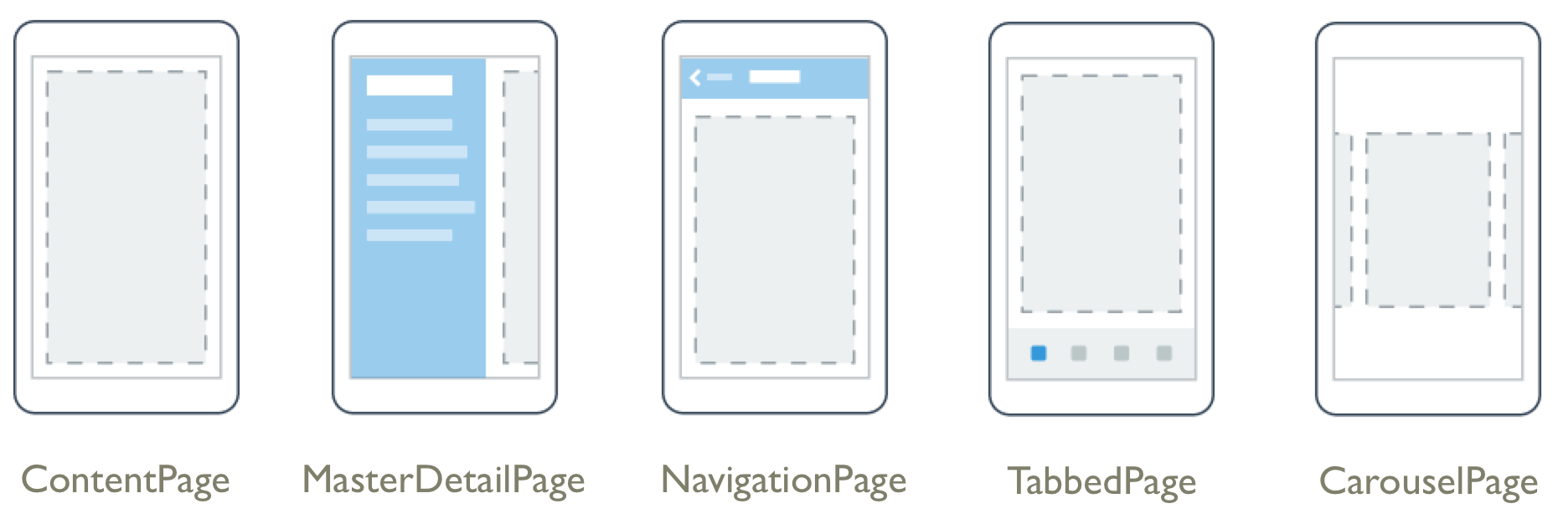
What is a Page?
A page is used to define a single screen that contains most or all of the screen.
Notes:
A Xamarin.Forms.Page represents a View Controller in iOS or a Page in Windows Phone. On Android each page takes up the screen like an Activity, but Xamarin.Forms Pages are not Activities.
ContentPage – A page that displays a single view.
MasterDetailPage – A page that manages two pains of information.
NavigationPage - A NavigationPage manages the transition between a stack of pages.
TabbedPage – A page that contains navigation between pages using tabs.
CarouselPage – A page who's navigation is achieved via swipe gestures between similar content (I.e. images or a listing of classes).

Slide 7
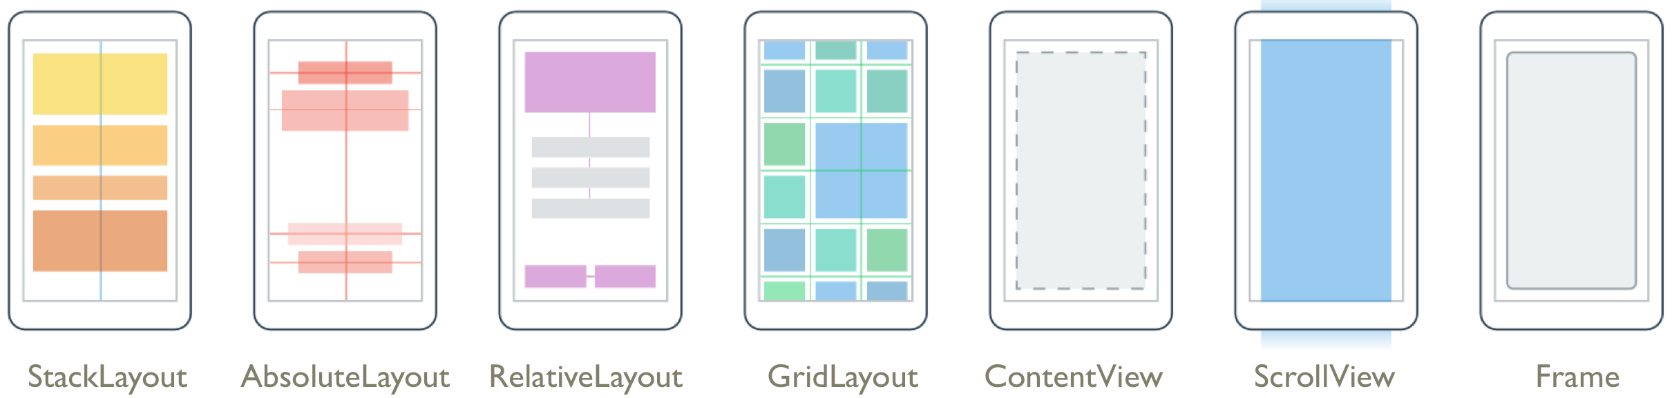
What is a Layout?
A layout is a special type of view that acts as a container for other views or layouts.
Notes:
A Xamarin.Forms Layout typically contains logic to set the position and size of child elements in Xamarin.Forms applications.
StackLayout – A Layout that positions child elements in a single line.
AbsoluteLayout – Positions child elements at absolute requested positions.
RelativeLayout – A Layout that uses Constraints to position its children.
GridLayout – A layout containing views arranged in rows and columns.
ContentView – An element with a single content. ContentView has very little use of its own. Its purpose is to serve as a base class for user-defined compound views.
ScrollView - An element capable of scrolling if it's Content requires.
Frame - An element containing a single child, with some framing options.

Slide 8
What is a View?
A View is the term Xamarin.Forms uses for all its basic controls from Buttons to Progress Bars.
Some of the Views Xamarin.Forms contains are
Button
Date Picker
Entry (input box)
Label
Picker (The phones form of dropdown list)
Progress Bar
A full list of Views at https://developer.xamarin.com/guides/cross-platform/xamarin-forms/controls/views/
Notes:
Views in Xamarin.Forms are the building blocks of cross-platform mobile user interfaces.
Platform defines a renderer for each view that creates a native representation of the UI

Slide 9
What is a Cell?
A Cell is a special element that is used inside tables and defines how each item in a list is rendered.
An example of Cells Xamarin.Forms supports:
Entry Cell
Switch Cell
Text Cell
Image Cell
A full list of Cells at https://developer.xamarin.com/guides/cross-platform/xamarin-forms/controls/cells/

Slide 10
Traditional way to build Forms apps
Xamarin.Forms apps are commonly built using all using C# and not XAML.
A new Xamarin.Forms app is usually created with a dummy app in a cs file
public App()
{
// The root page of your application
MainPage = new ContentPage {
Content = new StackLayout {
VerticalOptions = LayoutOptions.Center,
Children = {
new Label {
XAlign = TextAlignment.Center,
Text = "Welcome to Xamarin Forms!“
}
}
}
};
}
Notes:
Mixing UI and behavior all in one file can make design and behavior harder to understand or change as the app grows.
Forces the developer to do all the work (no way to include a designer unless they understand code as well)

Slide 11
XAML Syntax & Behavior

Slide 12
What is XAML?
XAML stands for Extensible Markup Language and was created by Microsoft specifically for working with the UI
A XAML file is always associated with a C# code file.
Notes:
talk about the content at the top, what standards its using, etc. (Xamarin.Forms conforms to XAML 2009 Specification, the differences are in the layout and containers used)

Slide 13
Why use XAML over all code in a .cs file?
Designer can create UI while coder focuses on code in the code file
XAML allows for features like DataBinding Animations, Custom behaviors, value converters & more.
Easier to work with for those who like to have a more visual representation of their layouts
Helps keep a separation between UI and app logic

Slide 14
Building a layout in XAML
<?xml version="1.0" encoding="utf-8" ?>
<ContentPage xmlns="http://xamarin.com/schemas/2014/forms"
xmlns:x="http://schemas.microsoft.com/winfx/2009/xaml"
x:Class="Toolbox.View.Page1">
<StackLayout>
<StackLayout.Padding>
<OnPlatform x:TypeArguments="Thickness“
iOS="0, 20, 0, 0"/>
</StackLayout.Padding>
<Label Text="{Binding MainText}" VerticalOptions="Center" HorizontalOptions="Center" />
</StackLayout>
</ContentPage>
Notes:
XAML Header:
Content Page:
Layout (usually):
Elements: (labels, buttons, pickers etc.)
While not essential to make a XAML file, XAML files may also contain things such as property elements, databinding, platform specific definition, and attached properties

Slide 15
XAML Syntax: Attached properties & Property Elements
<?xml version="1.0" encoding="utf-8" ?>
<ContentPage xmlns="http://xamarin.com/schemas/2014/forms"
xmlns:x="http://schemas.microsoft.com/winfx/2009/xaml"
x:Class="Toolbox.View.MunitConverter“>
<StackLayout VerticalOptions="CenterAndExpand" Padding="20" >
<Grid HorizontalOptions="Center" >
<Grid.RowDefinitions>
<RowDefinition Height="*"/>
<RowDefinition Height="*"/>
<RowDefinition Height="*"/>
<RowDefinition Height="*"/>
<RowDefinition Height="*"/>
<RowDefinition Height="*"/>
<RowDefinition Height="*"/>
<RowDefinition Height="*"/>
</Grid.RowDefinitions>
...
<Label x:Name="endLabel" Grid.Row="7" StyleId="EndLabel" XAlign="Center"/>
</Grid>
</StackLayout>
</ContentPage>
Notes:
Layouts such as the grid has special property called attached properties.
Attached properties are set in the child of a tag like grid.
Attached properties are easy to tell because they contain both a class and property name
They get their name because they are defined by one class but attach to other objects

Slide 16
XAML Syntax: OnPlatform & OnIdiom
<?xml version="1.0" encoding="utf-8" ?>
<ContentPage xmlns="http://xamarin.com/schemas/2014/forms"
xmlns:x="http://schemas.microsoft.com/winfx/2009/xaml"
x:Class="Toolbox.View.Page1">
<StackLayout>
<StackLayout.Padding>
<OnPlatform x:TypeArguments="Thickness“
Android="0, 0, 0, 0“
iOS="0, 20, 0, 0“
WinPhone="0, 0, 0, 0"/>
</StackLayout.Padding>
<StackLayout.BackgroundColor>
<OnIdiom x:TypeArguments="Color“
Phone="Teal“
Tablet="Green"/>
</StackLayout.BackgroundColor>
<Label Text="{Binding MainText}" VerticalOptions="Center" HorizontalOptions="Center" />
</StackLayout>
</ContentPage>
Notes:
OnPlatform: defines properties based on if it is an Android, iOS or Windows device
OnIdiom: defines properties specific to a phone or tablet
As of right now, you cannot use OnPlatform and OnIdiom together. Instead it requreies you to think about your latouts i.e. using a grid for autosizing or setting stack orientation to vertical on phone and horizontal on tablet.

Slide 17
XAML Syntax: OnPlatform & OnIdiom
OnPlatform allows us to define code for a specific platform
OnIdiom allows us to define code for either a tablet or phone
Both are useful for providing those quick tweaks to get the UI to look the same on all devices or only changing one platform to fit the rest of their needs
Notes:
OnPlatform: defines properties based on if it is an Android, iOS or Windows device
OnIdiom: defines properties specific to a phone or tablet
As of right now, you cannot use OnPlatform and OnIdiom together. Instead it requreies you to think about your latouts i.e. using a grid for autosizing or setting stack orientation to vertical on phone and horizontal on tablet.

Slide 18
Advanced XAML

Slide 19
Using Resource Dictionary
A Resource Dictionary is a dictionary that is specifically for use within the UI
Can be defined in the XAML or Code behind
Use the x:Key to define the ID of the dictionary entry so you can reference it later
Notes:
Resource dictionary’s help keep your XAML clean and helps you to not redefine elements (its like a css for XAML)
Can Use OnPlatform & OnIdiom to set resources (platform or device dependicies)
You can also set styles in your resource dictionary (starting with <Style TargetType=”button”>
and then define setters inside <Setter Property=“BackgroundColor” Value=“#2A84D3/>
Just remember that the properties must be members of the TargetType class or else a runtime error will occour

Slide 20
Using Resource Dictionary
<?xml version="1.0" encoding="utf-8" ?>
<ContentPage xmlns="http://xamarin.com/schemas/2014/forms"
xmlns:x="http://schemas.microsoft.com/winfx/2009/xaml"
x:Class="Toolbox.View.Page1“ BackgroundColor="White">
<ContentPage.Resources>
<ResourceDictionary>
<Color x:Key="TxtRed">Red</Color>
<OnPlatform x:Key="TxtColor“ x:TypeArguments="Color“ Android="Green“ iOS="Teal“
WinPhone="Purple"/>
<LayoutOptions x:Key="HorzCenter">Center</LayoutOptions>
</ResourceDictionary>
</ContentPage.Resources>
<StackLayout>
<Label Text="Im a label" HorizontalOptions="{StaticResource HorzCenter}“
TextColor="{StaticResource TxtColor}" />
<Label Text="Im a label too, but different" HorizontalOptions="{StaticResource HorzCenter}“
TextColor="{StaticResource TxtRed}"/>
<Label Text="Im also a different label but look like the first label"
HorizontalOptions="{StaticResource HorzCenter}“
TextColor="{StaticResource TxtColor}"/>
</StackLayout>
</ContentPage>
Notes:
Resource dictionary’s help keep your XAML clean and helps you to not redefine elements (its like a css for XAML)
Can Use OnPlatform & OnIdiom to set resources (platform or device dependicies)
You can also set styles in your resource dictionary (starting with <Style TargetType=”button”>
and then define setters inside <Setter Property=“BackgroundColor” Value=“#2A84D3/>
Just remember that the properties must be members of the TargetType class or else a runtime error will occour

Slide 21
Resource Dictionary hierarchy
Resource files can inherit from global resource files
Resource files prioritize definitions closer to where they started in the hierarchy.
Order of priority is View, Layout, Page, Application
Notes:
Page specific resources take presidence over app wide resources
App wide resources are where the end of the line is. If it cant find it after checking app wide, then it will error.
One page cannot call resources from another page

Slide 22
Resource Dictionary Hierarchy
App.xaml
<ContentPage.Resources>
<ResourceDictionary>
<x:String x:Key="TxtL1">I’m different</x:String>
</ResourceDictionary>
</ContentPage.Resources>
Page1.xaml
<ContentPage.Resources>
<ResourceDictionary>
<x:String x:Key="TxtL1">Im a label</x:String>
</ResourceDictionary>
</ContentPage.Resources>
<StackLayout>
<Label Text="{StaticResource TxtL1}"></Label>
</StackLayout>

Slide 23
Hands on Lab

Slide 24
What’s Next?
Data Binding with Xamarin.Forms & XAML
List views and collections with Data Binding, XAML, & Xamarin.Forms

Slide 25
Questions?
mitchmuenster@gmail.com
@MobileRez
mobilerez.tumbler.com

Slide 26
Data Binding + XAML + Forms

Slide 27
Data Binding + XAML + Forms

